Slide 1

Bagaimana kreativitas terjadi
Help everyone to learn faster

Slide 2
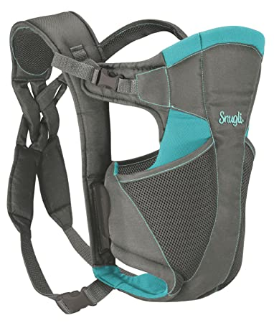
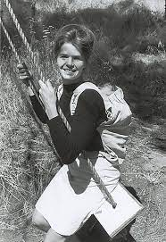
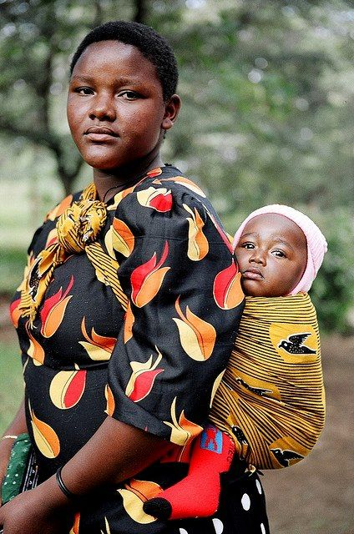
Help everyone to learn faster

Slide 3

Ringkasan
Datang
dari
berbagai
sumber
Bersedia
berpikiran
aneh
Kreativitas
dapat
dipelajari
Help everyone to learn faster

